Slide 1
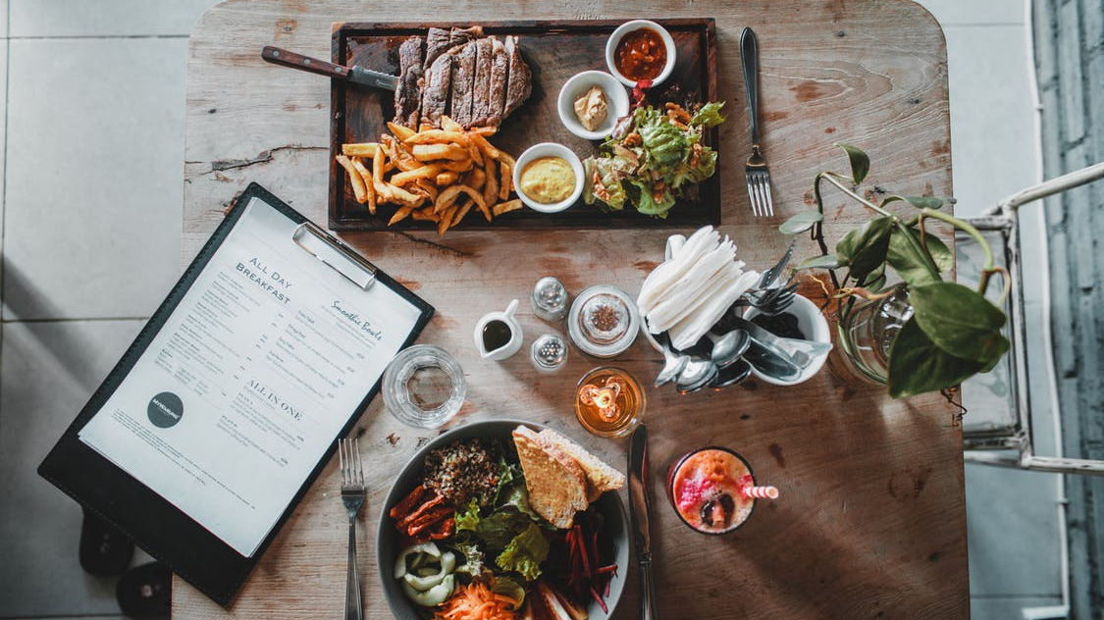
Food Recommendation Project
By - Jonathan Feng

Slide 2

Project Overview
Why are recommendation apps important?
Possible Applications?
Spotify
Our Project
Working with Recommendations.
Further applications in our case.

Slide 3


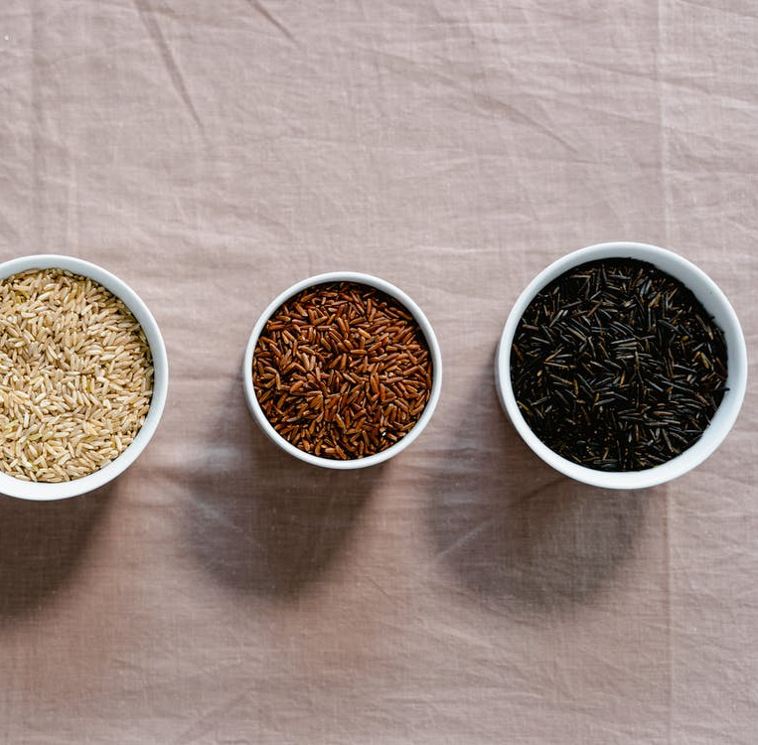
Data Overview
food.csv
preprocessed_data.csv

Slide 4
Project Flow
Step 1
PCA Dimensionality Reduction
Step 2
Data Exploration: Elbow Method & K-means
Step 3
Distance Matrix & Prediction
Step 4
Integrated Outputs

Slide 5
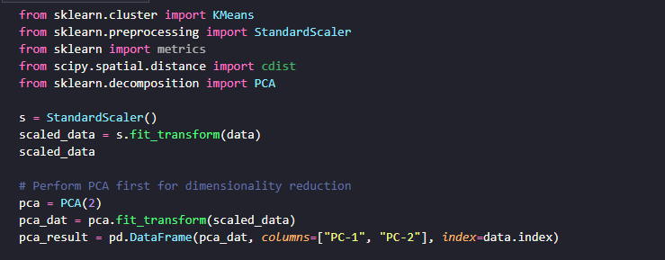
PCA (Principal Component Analysis)

Slide 6
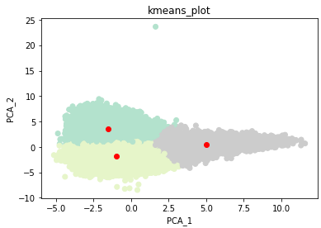
Data Exploration: Elbow Method & K-means

Slide 7
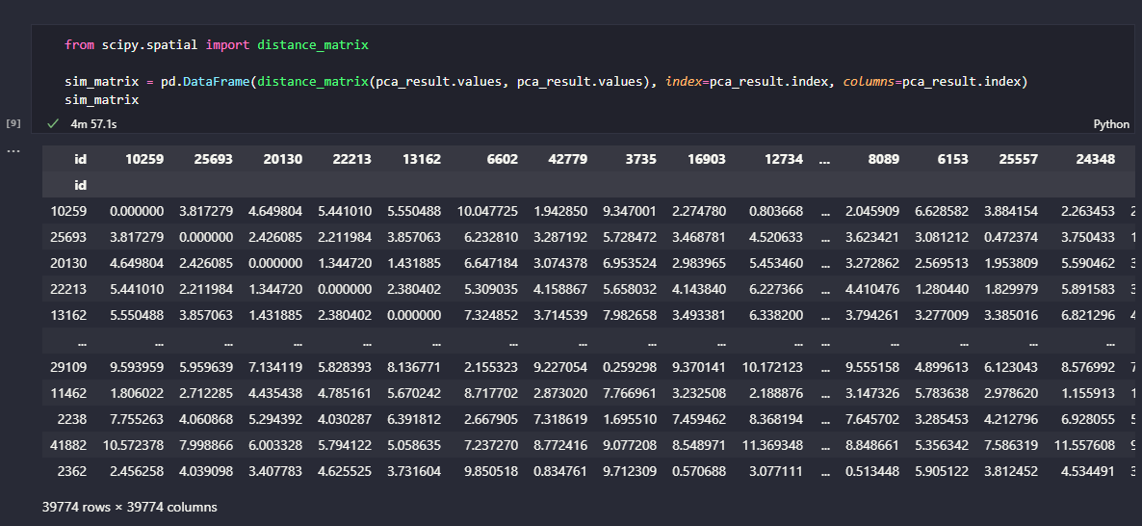
Distance Matrix & Prediction

Slide 8
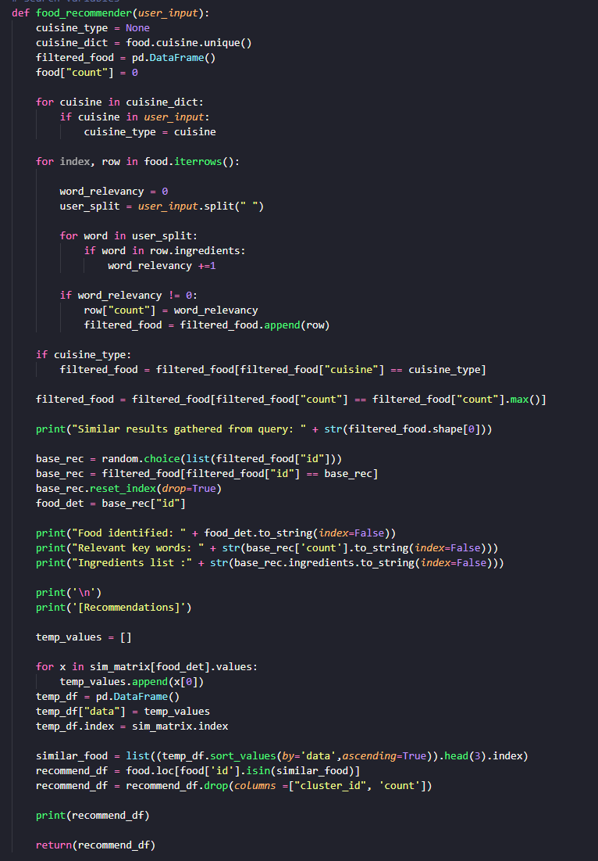

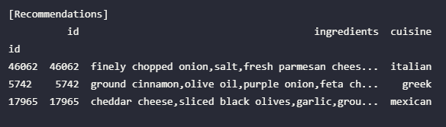
Outputs & Code Demo I

Slide 9
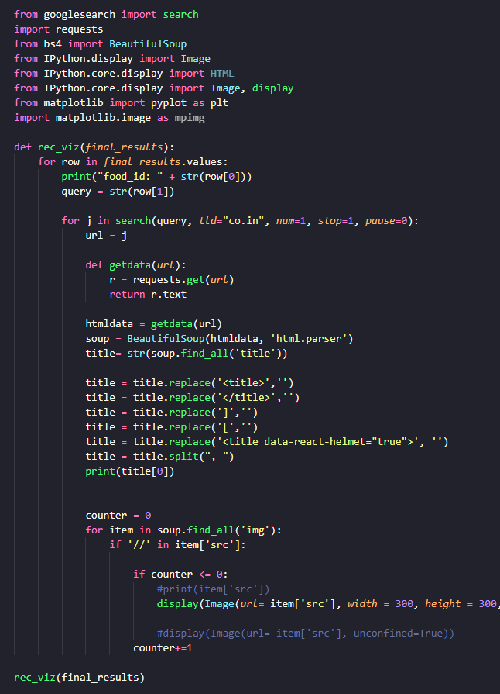
Outputs & Code Demo II

Slide 10
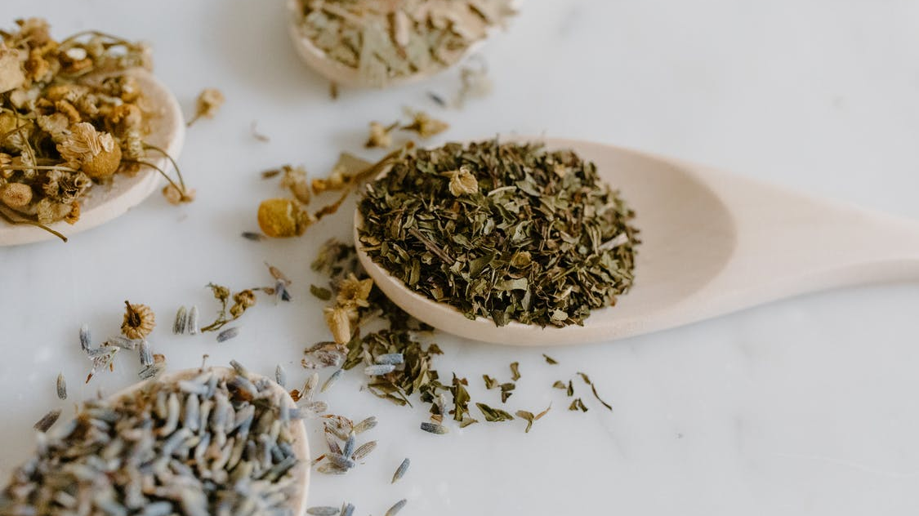
Thank You!

